Slide 1
Neural Graphical Models over Strings for Principal Parts Morphological Paradigm Completion
Ryan Cotterell, John Sylak-Glassman, and Christo Kirov
Notes:
Neural Graphical Models Over Strings for Principal Parts Morphological Paradigm Completion

Slide 2

Co-Authors
Ryan Cotterell
John Sylak-Glassman
Notes:
This is work with Ryan Cotterrell and John Sylak-Glassman who unfortunately weren’t able to be here today

Slide 3
Problem Overview – Morphological Paradigm Completion
Notes:
Problem we are going to address is morphological paradigm completion

Slide 4
Morphological Paradigms
breche
brach
brichst
brachst
gebracht
brechen
brachen
Notes:
German lemma brachen
Different inflected forms of a single lemma – form paradigms…
You can see that in many cases, SLOTS in a paradigm are formally related, sharing a significant amount of phonological content
Each of these forms fits into a paradigm SLOT, corresponding to some set of morphological features

Slide 5
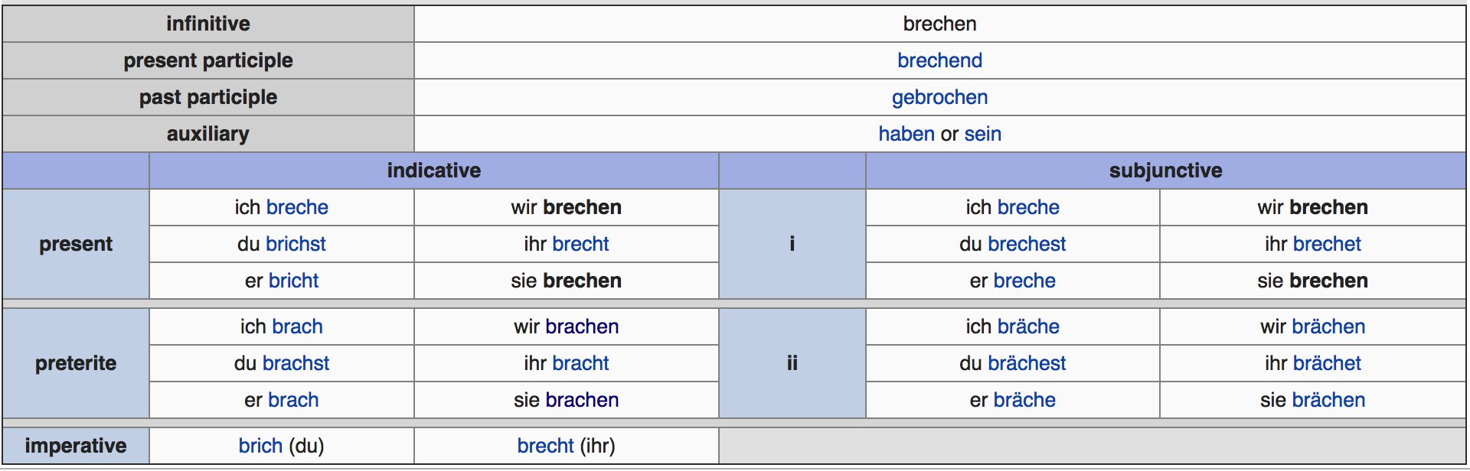
Morphological Paradigms
Notes:
German lemma brachen
Different inflected forms of a single lemma – form paradigms…
You can see that in many cases, SLOTS in a paradigm are formally related, sharing a significant amount of phonological content
Each of these forms fits into a paradigm SLOT, corresponding to some set of morphological features

Slide 6
Paradigm Completion
?
brach
?
brachst
?
Question: can we generate morphologically related words?
brechen
?
Notes:
We are concerned with the following problem: if we observe some of the slots in a paradigm, but not all, how can we recover all the rest?

Slide 7
Why this matters!
Inflection generation useful for:
Dictionary/Corpus Expansion
Parsing (e.g., Tsarfaty et al. 2013; references therein)
Machine Translation (e.g., Täckström 2009)
etc.
Notes:
Why do this?
In many of the world’s languages a given lemma (or citation form) can have hundreds of forms. This creates serious sparsity issues for various NLP applications
that morphological generation can help to alleviate
Recently – knowledge of morphogy has been shown useful for various downstream tasks

Slide 8
Our Approach
Most of the community effort has focused on modeling pairs of variables with supervision
E.g., brachen -> brechen
E.g., brachen -> gebracht
like neural MT
We focus on joint decoding of ALL uknown paradigm slots given ALL known slots
Natural way to capture correlations in output structure
Notes:
most of the community is focusing on modeling individual relationships between pairs of paradigm slots
usually the concern is mapping a lemma form to some other paradigm slot
this is a sequence-2-sequence problem and is very similar, for example, to neural machine translation, and can be solved by many of the same tools
Instead, we focus on a different setting, where we want to jointly recover ALL the missing forms in a paradigm, given all the forms we have observed. This allows us to combine information from multiple cells to reconstruct the missing forms!

Slide 9
Our Approach
Joint probability distributions over a tuple of strings
String-valued latent variables in generative models (e.g., Dreyer & Eisner, Cotterell & Eisner, Andrews et al.)
Inference: What unobserved strings could have generated gebracht?
Research Questions:
How do we parametrize the distributions?
How can we perform efficient inference?
Can we learn predictive parameters in practice?
Notes:
Our approach builds on previous work by Dreyer and Eisner, Cotterrell and Eisner, Andrews,
We will do this joint decoding by modeling joint probability distributions over tuples of multiple strings
That is, we built GENERATIVE models over string-valued LATENT variables
This allows us to infer the values of those variables – we can ask questions like,
if we observe gebracht, what strings could have generated it?
In this talk, we will discuss a number of research questions related to this framework
how do we parameterize the joint distributions?

Slide 10
The Formalism – Graphical Models over Strings
Notes:
We will focus on the formalism of graphical models over string-valued variables
Our approach builds on previous work by Dreyer and Eisner, Cotterrell and Eisner, Andrews, and others on formalizing the idea of graphical models over string-valued variables

Slide 11
Review: Factor Graph Notation
A
B
C
D
E
Notes:
To begin, I’m going to quickly review the notation for factor graphs in general
A factor graph is a probabilistic graphical model that models a joint distribution of variables as a product of factor functions, also called potential functions
Factor functions are any positive functions over arbitrary subsets of variables
For our purposes, however, we will only be concerned with factors over PAIRS of variables.

Slide 12
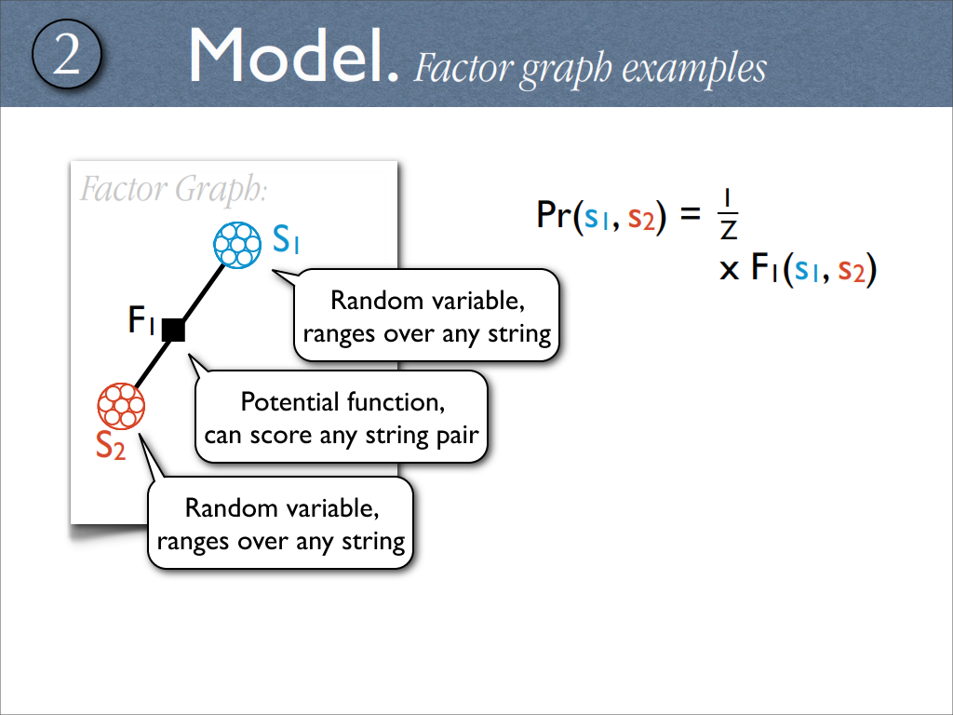
Example Factor Graph
Notes:
So here’s an example of a simple factor graph.
There are two random variables, each of which ranges over any string.
The two variables are connected by a factor, so their joint probability distribution is just the value of that factor normalized for all possible string pair combinations.

Slide 13
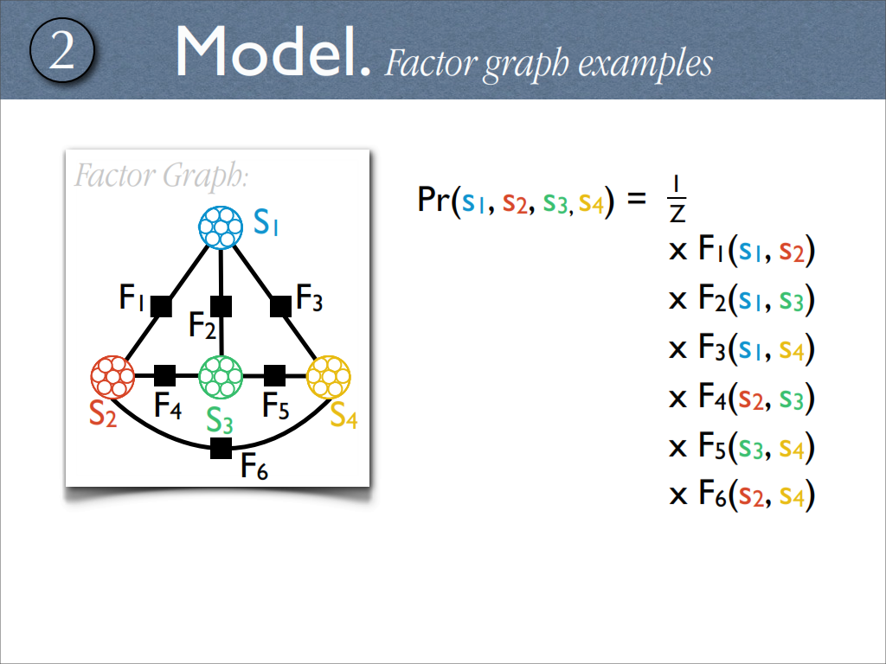
Example Factor Graph
Notes:
Factor graphs can get more complicated.
This time, we have 4 string-valued variables, with various binary factors between them.
However, the joint probability is calculated in exactly the same way -> proportional to the product of the factors.

Slide 14
Inference through Message Passing
Notes:
Given a factor graph, we can perform inference about latent (or unobserved) variables, that is, unobserved inflected wordforms, using message passing, or belief propagation, algorithms

Slide 15
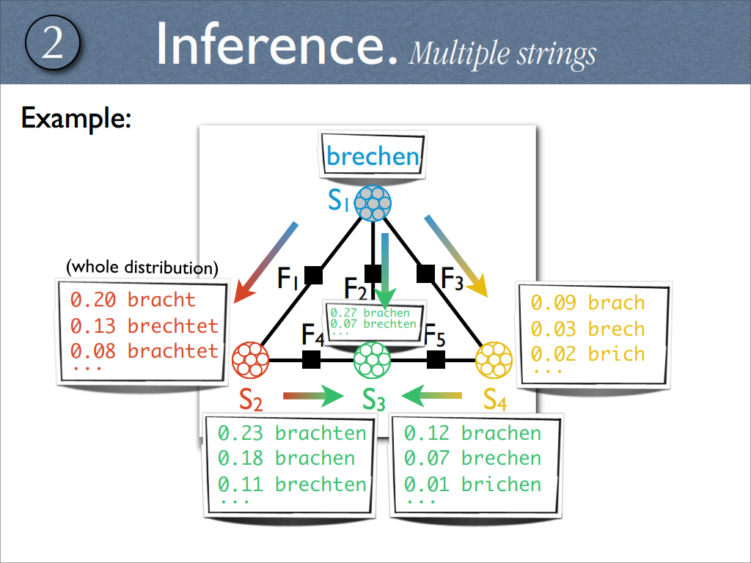
Inference: Belief Propagation
Notes:
These algorithms use the factor functions to calculate ’messages’ that are passed between the variables in the graph.
These messages, which themselves look like probability distributions, indicate the likelihood of different states of a string-valued variable given the rest of the graph.

Slide 16
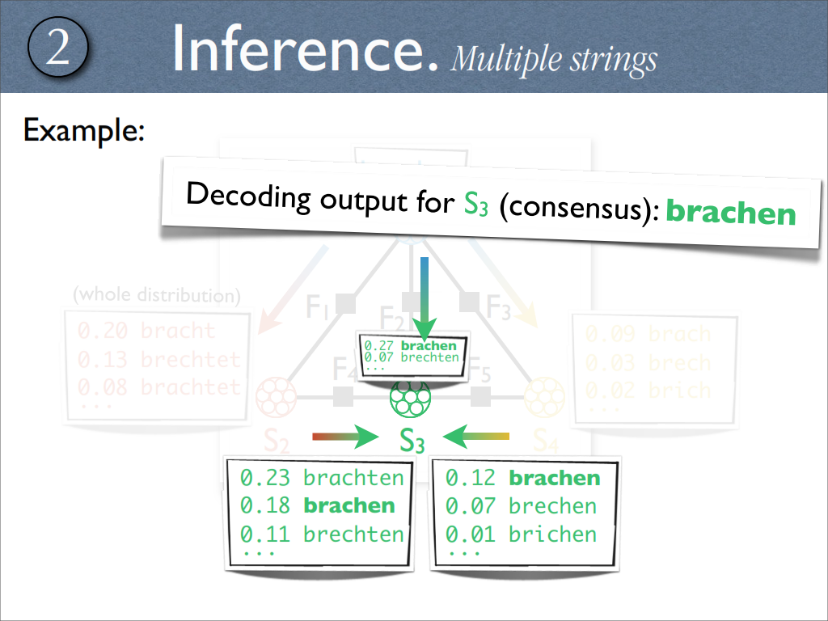
Inference: Belief Propagation
Notes:
to select a particular state for a variable, that is, a particular wordform, we take a consensus of all its incoming messages

Slide 17
Paradigm Graphs
Notes:
Ok, so how can we apply graphical models, particularly factor graphs to morphological paradigms?
We just treat each SLOT in the paradigm as a variable, and create edges between the resulting nodes…

Slide 18
Morphological Paradigm: Spanish Verbs
”to put”
poner
puso
pongo
pusimos
pondría
pusieron
pongamos
Notes:
Here is a partial graph for Spanish verbs. Every variable in the graph corresponds to particular paradigm slot, with each string value corresponding to an inflected form. The edges in the graph can be viewed as factors that describe formal relations between the word forms.

Slide 19
Morphological Paradigm: Spanish Verbs
”to put”
poner
puso
pongo
Fully connected graph has ~N² factors!
pusimos
pondría
pusieron
pongamos
Too Many Parameters!
Notes:
Unfortunately, especially in languages with many paradigm slots, the fully connected paradigm graph is difficult to work with due to its large size.
N^2 factors
’Loopy’ message passing is required, but is not guaranteed to converge.

Slide 20
Paradigms can be viewed as Tree Structured (e.g., Narasimhan et al. 2015)
”to put”
poner
puso
pongo
pondría
pusimos
pusieron
pongamos
Notes:
So, we pursued a method of reducing the graph to something more manageable. In particular, we decided to pare down paradigms to directed trees. These were inspired by the idea of principal parts in Latin pedagogy. Every student of Latin is taught that all verb forms can be derived from four principal parts. Here, we reduce the problem of inference by capitalizing on the idea that certain forms are most deterministically derived from other particular forms.

Slide 21
Morphological Paradigm Tree: Spanish Verbs
Generative Model
of a Tuple of Strings
poner
puso
pongo
pondría
pusimos
pusieron
pongamos
Conditional Distributions play the Role of Factors!
Notes:
This allows for a convenient formulation of the generative model over all the forms in the paradigm!
Each edge in the graph can be defined by a conditional distribution, and the joint probability of all the variables is just a product of these conditionals
Note that these conditionals play the role of the factors in this graph
Also note that we can still use message passing to infer un-observed variables, and that the tree structure gives us theoretical guarantees about convergence that we wouldn’t get from a ”loopy” paradigm graph

Slide 22
Recurrent Neural Factors

Slide 23
Morphological Paradigm Tree: Spanish Verbs
Generative Model
of a Tuple of Strings
poner
puso
pongo
pondría
pusimos
pusieron
pongamos
Each conditional is a seq2seq model (Aharoni et al. 2016)!
Notes:
Previous work by Cotterrell and Eisner parameterized conditional factors like these using weighted finite-state automata. However these are difficult to build via machine learning, and limit the possible set of relationships between forms to those that are strictly finite-state.
Instead, we choose to describe the conditional distributions using sequence2sequence neural networks!
The parameters of these distributions can be estimated using standard gradient descent training given pairs of forms in the training data…
WE TRAIN IN BOTH DIRECTIONS

Slide 24
Which Tree?

Slide 25
Which Tree?
Baseline Tree
(lemma-rooted)
Notes:
So it’s great if we can make a tree for the paradigm. But which tree should we choose? What’s the best way to prune the fully connected graph?
One simple idea, is to make the dictionary form of a lemma the root of the tree, and to have all the other forms radiate out. We treat this arrangement as a baseline for all our experiments.
It’s important to note what happens if the lemma is an observed variable in this tree. It effectively blocks messages from passing between non-lemma variables, reducing the joint inference problem to a series of binary inference problems.

Slide 26
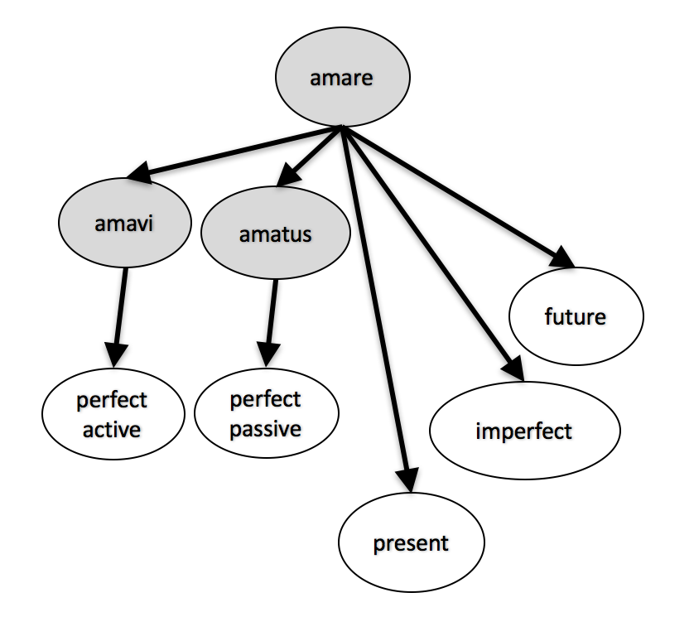
Which Tree?
‘Gold’ Tree
Latin verb “to love”
amo, amare, amavi, amatus
’Principal Parts’ intuition
Based on Linguistic Scholarship
Used in Pedagogy
Principal Parts Analysis (Finkel & Stump 2007)
Notes:
Can we do something better?
Well, there’s an intuition from linguistics that not all relationships between inflected forms are equally informative.
Certain inflected forms are privileged because if you know them, you can derive all the rest of the forms in the paradigm deterministically.
If you’ve ever studied Latin verbs, you might have heard of these privileged forms referred to as ’principal parts’.
In Latin pedagogy, verbs are described as having 4 principal parts. For example, ”amo, amare, amavi,” and “amatus”. We can refer to this body of linguistic scholarship to design a paradigm tree that privileges these forms – SHOWN TO THE RIGHT
We follow work by Stump and Finkel in generalizing the idea of principal parts to other languages, and moreover expand the notion to include not just relationships in which the derivation of a form is fully deterministic, but relationships that maximize the determinism of the relation.

Slide 27
Which Tree?
Heuristic Tree (Linguistically-Inspired)
Keep only the most deterministic edges! (e.g., Ackerman & Malouf 2013)
Edge Weight = # edit paths (Chrupala 2008)
Find minimal directed spanning tree
(Edmonds 1967)
Notes:
However, doing the linguistic research necessary to manually come up with an ‘optimal’ paradigm tree can be very time consuming, especially if we’re dealing with languages that may not have the level of accumulated scholarship that Latin does. Instead, we can try to use some heuristics to approximate an optimal tree.
The main idea is to prune a fully connected paradigm graph in order to keep only the deterministic edges, or in other words, the edges that permit the easiest inference.
In order to do this, we calculate a weight for each edge in a quick and dirty way. Starting with any training data we have available, we count the number of different sets of edit operations (consisting of subsitituions, deletions, and insertions) that can convert a form on one side of the edge to a form on the other side.
If there are lots of different ways to convert one form to another, then the edge is probably not very deterministic
So, we run a minimal spanning tree algorithm on the graph to prune away the most uncertain edges, keeping only the most deterministic edges in the final tree…
In our experiements, we will compare these linguistically-inspired graphs to the simple baseline graphs I showed earlier

Slide 28
How do we do Inference?
Neural factors give flexibility, but lose tractable closed-form inference
Approximate MAP via Simulated Annealing
Modified Metropolis-Hastings MCMC
Notes:
So, given a tree-structured graph parameterized with neural network factors for computing conditional distributions, how do we actually perform inference to recover unobserved variables?
Unfortunately, while approximate message passing using weighted-finite state automata factors has a closed-form solution, the use of neural factors requires a sampling step when calculating messages
TBD

Slide 29
Pseudocode
Notes:
TBD

Slide 30
Overview
Repeat Until Convergence
Select latent variable at uniform
Sample a new string value for the variable
Select neighboring edge at uniform
Sample string from Neural Net for that edge
Accept with probability
Reduce τ to approximate MAP estimate (simulated annealing)
Notes:
So, given a tree-structured graph parameterized with neural network factors for computing conditional distributions, how do we actually perform inference to recover unobserved variables?
Unfortunately, while approximate message passing using weighted-finite state automata factors has a closed-form solution, the use of neural factors requires a sampling step when calculating messages
TBD

Slide 31
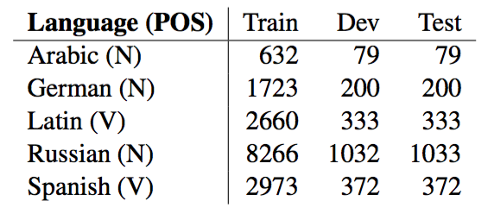
Experiments
Compared Baseline/Gold/Heuristic paradigm graphs
Recover 2/3 of forms in test paradigms given the lemma and remaining 1/3 of forms
All paradigm data from Wiktionary (wiktionary.org)
Notes:
Now that I’ve talked about how our model works, I’ll quickly discuss some experiments.
We wanted to compare how well the different tree structures I discussed earlier compared to each other. The baseline tree with everything radiating from the lemma, the Gold principal-parts tree based on linguistic scholarship, and the heuristic tree that quickly approximates a gold tree based on the idea that principal parts are used to maximize the determinism in deriving forms from one another.
We built graphs for Arabic, German, Latin, Russian, and Spanish. For all of these languages, we trained neural network sequence2sequence models for each edge in each tree. This was done using pairs of forms from complete paradigms in our training set.
With trained neural networks, we were able to perform inference over the graphs using message passing.
For our test condition, we attempted to recover 2/3 of the forms in each test paradigm, given only the remaining 1/3.

Slide 32
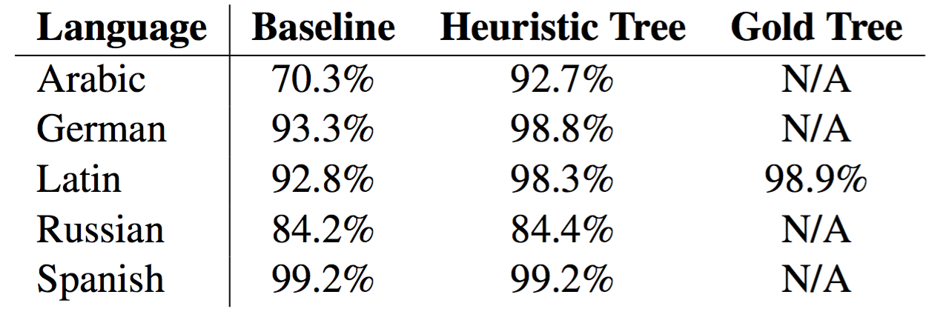
Results
Notes:
And here are the results, showing the percentage of paradigms the model got completely right.
We see that our heuristic graphs, based on keeping only the most deterministic relationships in the paradigms, work better than the simple lemma-rooted graphs, though the benefits are not equal for all the languages
-Arabic benefits the most by far
-Spanish and Russian benefit the least (most relationships equally informative?)
Unfortunately, we only had a Gold Tree for Latin. And it did indeed perform the best. However, the difference between the gold graph structure and our heuristically derived one was insiginificant, suggesting that our heuristics reasonably approximate the construction of a gold tree.

Slide 33
Extensions
Framework applies to any inference problem over mutually related sets of strings.
Possible application: Cognate Reconstruction
discover transliteration relations across different languages in a family to augment dictionaries, e.g. use high-coverage dictionaries of high-resource language to infer entries for related low-resource language.
tree-shaped graphs relevant for historical reconstruction (e.g., Bouchard-Cote 2007)
Notes:
What are some directions we can take moving forward?
We can always put in more engineering effort to make our implementations faster, but more generally,
this framework can be applied to any inference problem over mutually related sets of strings, where the relationships can be defined by binary factors.

Slide 34
Thank You! http://aclweb.org/anthology/E17-2120
DAAD Long-Term Research Grant,
NDSEG Fellowship, and
DARPA LORELEI
ryan.cotterell@jhu.edu
jcsg@jhu.edu
ckirov@gmail.com

Slide 35
References
Täckström, Oscar. 2009. “The Impact of Morphological Errors in Phrase-based Statistical Machine Translation from German and English into Swedish.” In Proceedings of 4th Language & Technology Conference, 546-550. Poznan, Poland.
Tsarfaty, Reut; Djamé Seddah; Sandra Kübler; and Joakim Nivre. 2013. “Parsing Morphologically Rich Languages: Introduction to the Special Issue.” Computational Linguistics 39(1): 15-22.
Finkel, Raphael; and Gregory Stump. 2007. “Principal parts and morphological typology.” Morphology 17:39-75. plus additional references listed in the proceedings paper
Notes:
What are some directions we can take moving forward?
We can always put in more engineering effort to make our implentations faster, but more generally,
Well, this framework applies to any inference problem over mutually related sets of strings, where the relationships can be defined by binary factors.

